Slide 1

CAPSTONE PROJECT
Customer Complaints Classification

Slide 2

Business Problem
The bank has observed that it sometimes takes a long time to respond to customer queries. This happens partly because the stakeholder who can resolve the customer complaint is usually not the first person who gets to look into the matter. This on an average delays the first effective response by 18 hours.
The bank wants to solve this problem by automating the process of assigning customer tickets to relevant stakeholders.
We need to help the bank to come up with a solution to be able to classify the customers’ tickets automatically with a reasonable degree of accuracy.

Slide 3
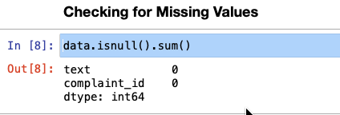
Data Overview
We have been given a dataset about customer complaints, pulled from the customer support desk of a leading multinational bank.
The data set contains two json files :
complaints.json which contains the complaint texts and complaint_id
mappings.json which contains the complaint_id or issue_id and dept_code
There is also a file called respondent.csv, which has the mapping of issue_id with respondent_id. This can be used to ascertain who should respond given the issue_id.
Dataset is devoid of any missing values and duplicated rows.

Slide 4
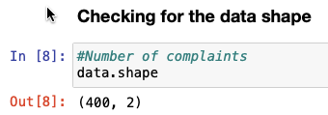
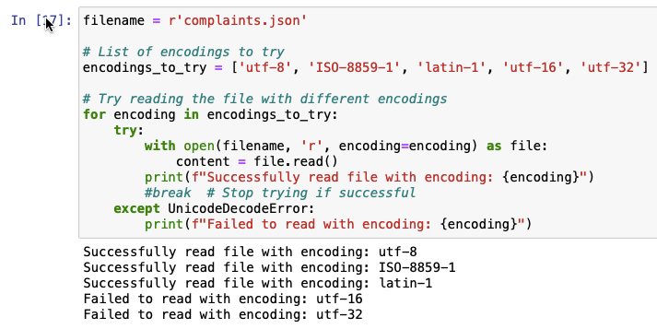
Exploratory Data Analysis
Dataset has a total of 400 labeled customer complaints.
Text data does not have any HTML Tagging
No encoding issues with this dataset

Slide 5
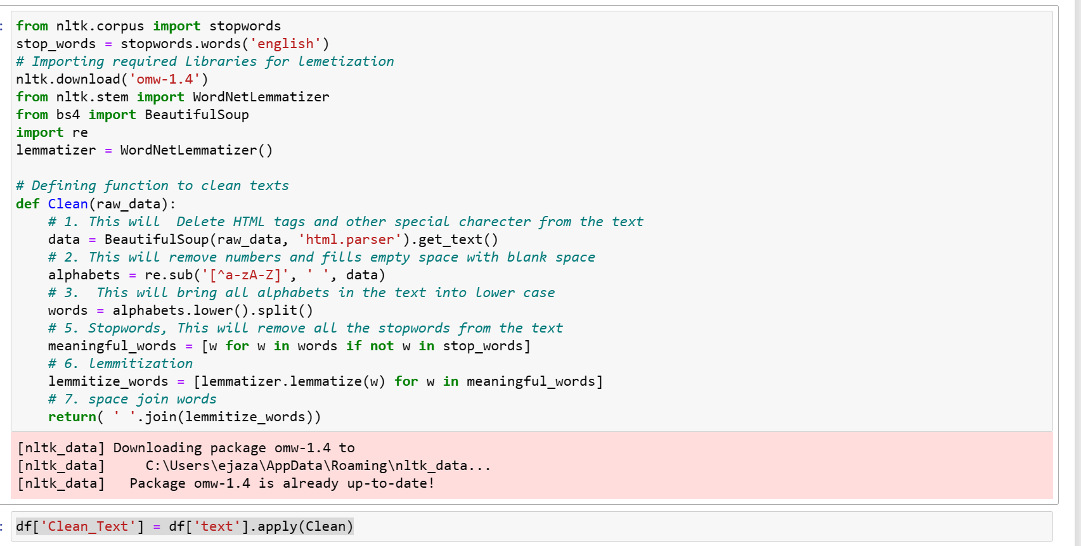
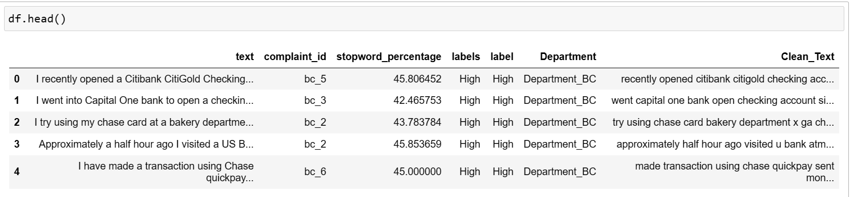
Performing Data Cleaning
Performing Data Cleaning
Remove tags, numbers, special charecters from the texts
Remove stopwords from the text
Conveert text into lower case
Apply Lammetization to reduce words to its lemma.

Slide 6
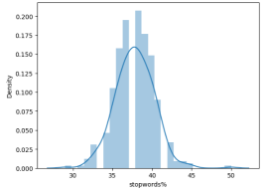
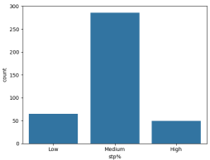
Exploratory Data Analysis
Around 72% of text data contains medium level of stop words and range lies between 35% - 40%
16% of text data contains Low level of stop words and range lies less than 35%
12% of text data contains High level of stop words and range lies more than 40%

Slide 7
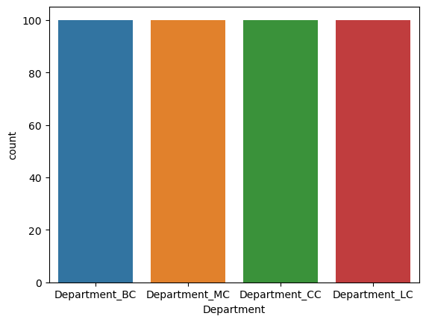
Exploratory Data Analysis
It is also observed that data is equally distributed under four major departments which are then categorized under various sub-departments:
• -- Department_BC = 25%
• -- Department_MC = 25%
• -- Department_CC = 25%
• -- Department_LC = 25%

Slide 8
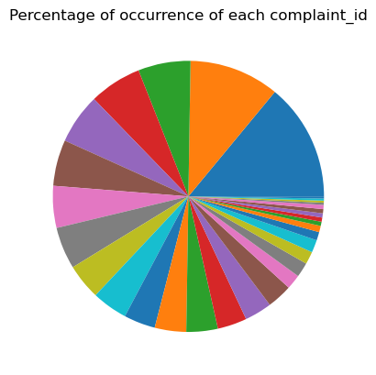
Exploratory Data Analysis
Student loan_lc_1: 14.00%
Consumer Loan_lc_0: 10.75%
Managing an account_bc_5: 6.25%
Conventional fixed mortgage_mc_1: 6.25%
FHA mortgage_mc_3: 6.00%
Using a debit or ATM card_bc_2: 5.50%
Problems caused by my funds being low_bc_0: 5.00%
VA mortgage_mc_4: 5.00%
Conventional adjustable mortgage (ARM)_mc_0: 4.25%
Customer service_cc_2: 4.25%
Billing disputes_cc_0: 3.75%
Deposits and withdrawals_bc_4: 3.75%
Advertising and marketing_cc_13: 3.75%
Conventional home mortgage_mc_2: 3.50%
Payoff process_cc_15: 3.25%
Fraud_cc_8: 3.00%
Account opening, closing, or management_bc_3: 1.75%
Company charging the account_bc_6: 1.75%
Rewards_cc_4: 1.50%
Cancelling account_cc_1: 1.50%
Problem caused by your funds being low_bc_1: 1.00%
Credit determination_cc_5: 0.75%
Other fee_cc_10: 0.50%
Credit card protection_cc_3: 0.50%
Other_cc_12: 0.50%
APR or interest rate_cc_7: 0.50%
Transaction issue_cc_9: 0.50%
Delinquent account_cc_11: 0.25%
Cash advance fee_cc_6: 0.25%
Late fee_cc_14: 0.25%
Payday loan_lc_2: 0.25%

Slide 9
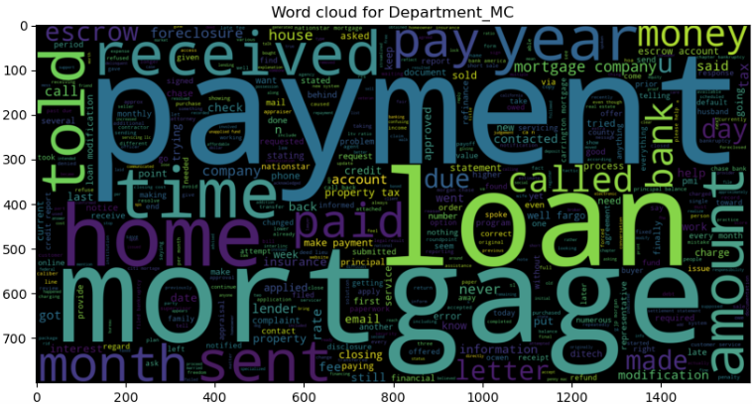
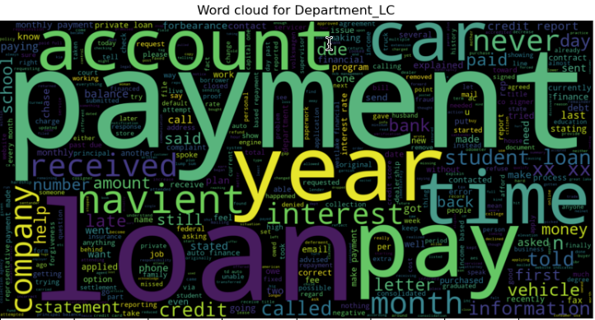
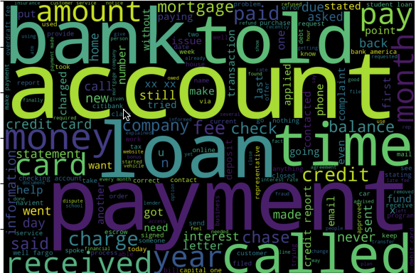
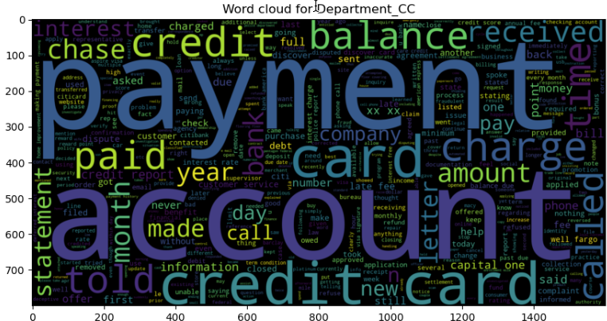
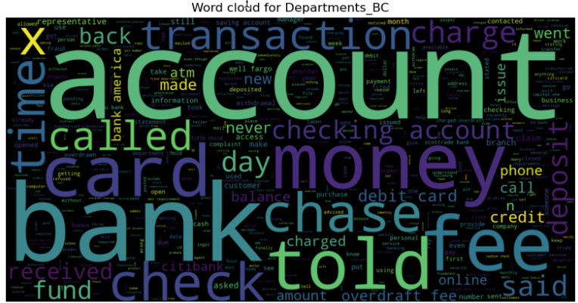
Feature Engineering
Unigram for entire corpus
Created Count matrix
Created Tfidf matrix using Unigram
Created WordCloud using Unigram and Bigram for better visualization of most frequently occuring words in corpus.
Unigram analysis shows most common words in complaints as bank, account, payment, loan.
Performed Word Embedding using Word2Vec technique.

Slide 10
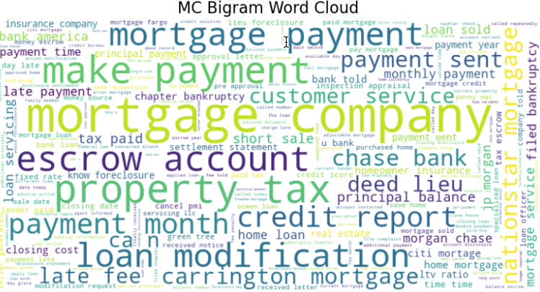
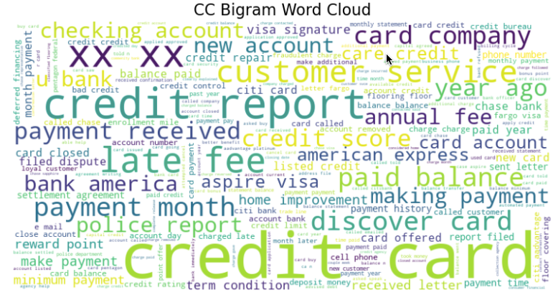
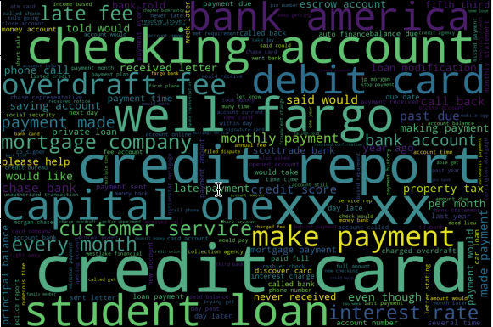
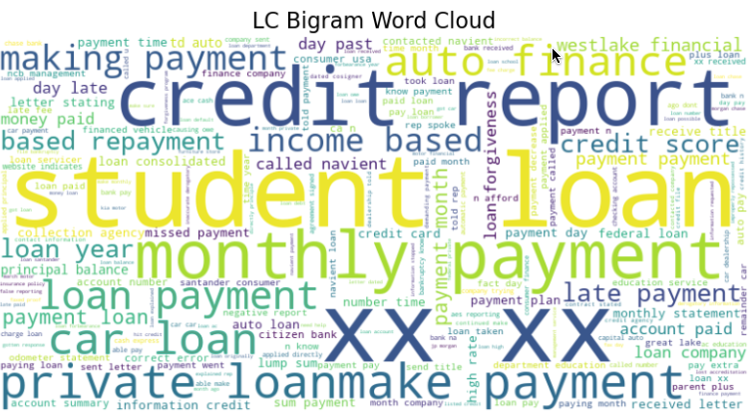
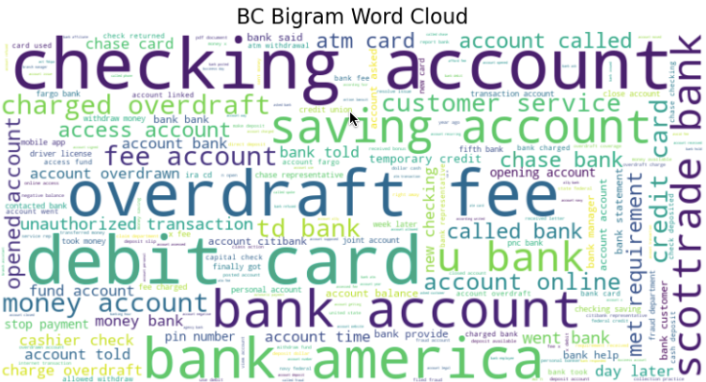
Feature Engineering
Bigram for entire corpus
Created Tfidf matrix using Bigram.
Bigram analysis shows most common words in complaints as credit card, checking account, credit report

Slide 11
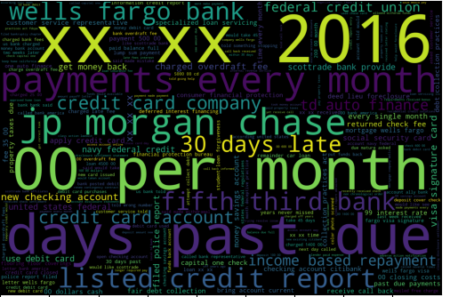
Feature Engineering
Trigram for entire corpus
Trigram analysis shows most common words in complaints as 00 per month, xx xx 2016, 30 days late, jp morgan chase

Slide 12
Modelling
List of the ML Models taken into Consideration:
SupportVectorClassifier
RandomForestClassifier
Naive Bayes Classifier
BERT (Bidirectional Encoder Representations from Transformers)
LSTM (Long Short-Term Memory)
k-Nearest Neighbors (KNN)
Dataset splitted into Training and Test data in the ratio of 80 : 20.
TfidfVectorizer is being used to tokenize and vectorize our text data for all the ML Models.
ML Model Performance is being judged on the basis of:
Accuracy Matrix
Precision Matrix
Recall Matrix
F1 - Score

Slide 13
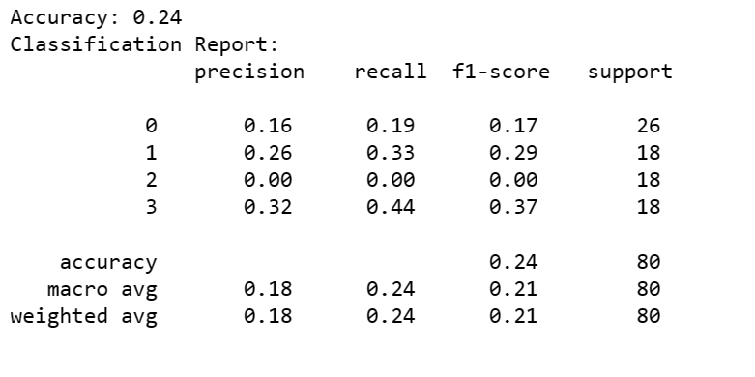
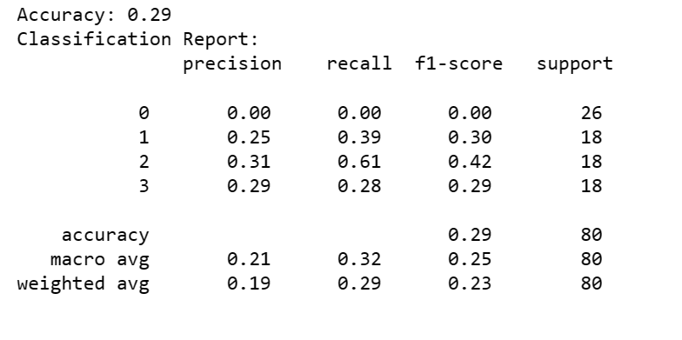
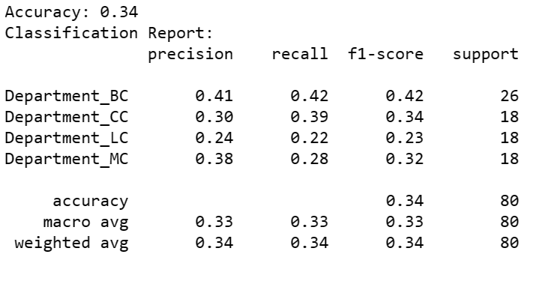
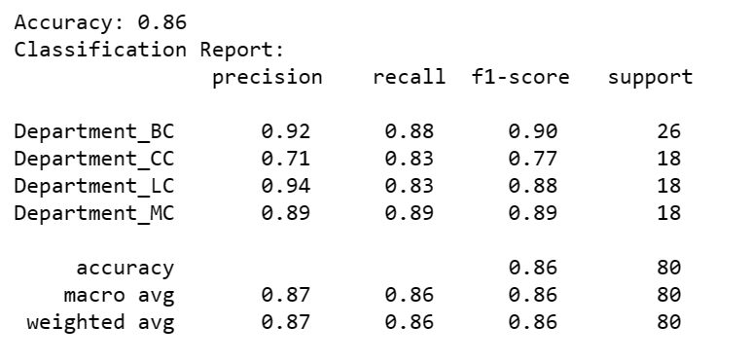
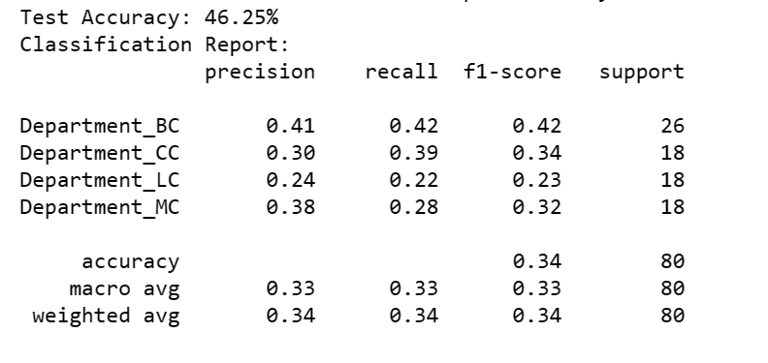
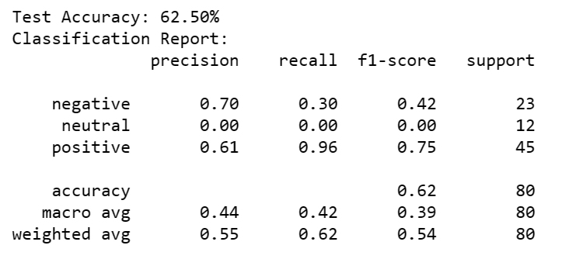
ML Models Performances
Naive Bayes Classifier
SVM
KNN
FINAL MODEL SELECTED
Random Forest Classifier
LSTM
BERT

Slide 14
Final Model : Random Forest Classifier
The overall accuracy of the Random Forest model is 86%, indicating that it correctly predicts the class labels for 86% of the instances in the test dataset.
Looking at the precision, recall, and F1-score for each class:
For Department_BC, the precision (0.92), recall (0.88), and F1-score (0.90) are relatively high, indicating that the model performs well in identifying instances of this class.
For Department_CC, while the precision (0.71) is moderate, the recall (0.83) and F1-score (0.77) are also reasonable, suggesting that the model performs decently but may have some difficulty in correctly identifying instances of this class.
For Department_LC, the precision (0.94) and F1-score (0.88) are high, indicating good performance, while the recall (0.83) is slightly lower.
For Department_MC, the precision (0.89), recall (0.89), and F1-score (0.89) are all high, indicating strong performance in identifying instances of this class.
The support column indicates the number of instances of each class in the test dataset, with Department_BC having the highest support (26 instances) and Department_CC having the lowest support (18 instances).
The macro avg and weighted avg metrics provide the average precision, recall, and F1-score across all classes, weighted by the number of instances in each class. In this case, both macro and weighted averages are around 0.86, which is consistent with the overall accuracy.

Slide 15
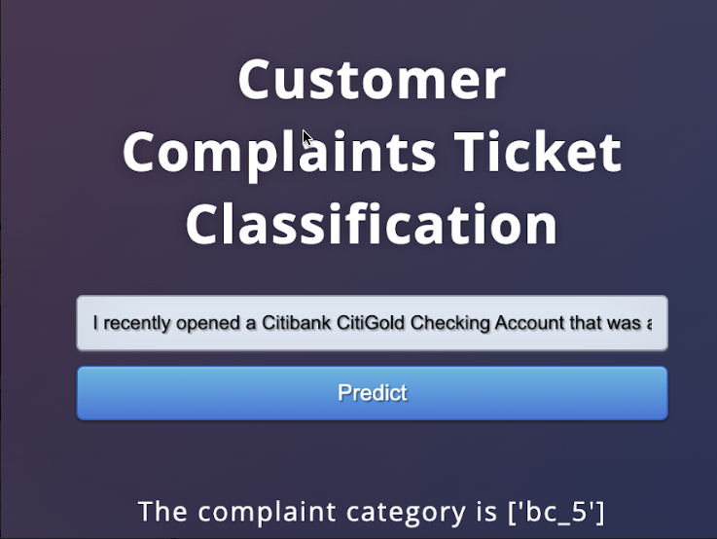
Deployment

Slide 16
Anjali Gautam
Ejaz Ahmad Haris
Saif Ali
Pabolu Venkata Krishna Teja

